Slide 1

Introduction to Security
DYNAMICS 365

Slide 2

Mitch Milam
mitch@xrmcoaches.com
@mitchmilam
linkedin.com/in/mitchmilam
youtube.com/xRMCoaches

Slide 3
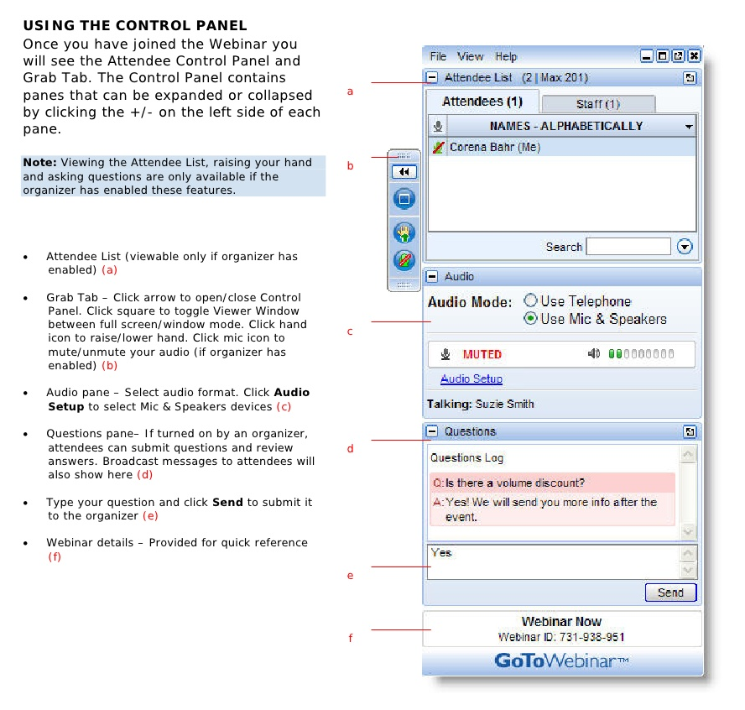
Webinar Housekeeping

Slide 4
Agenda
What we will cover today:
Business units
Users
Teams
Security Roles
Encryption
Hierarchy security

Slide 5
Organization and Security
Business Units
Security Roles
Privileges
Access Levels
Users
Teams

Slide 6
Business Units

Slide 7
Business Units
Business Units define your organizational hierarchy:
User and Teams
Security

Slide 8
Business Units
Two types of business units
Root business unit
All other business units

Slide 9
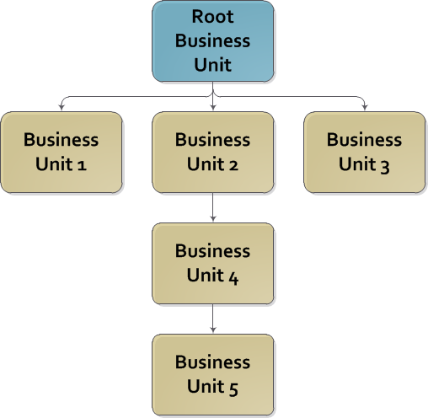
Root Business Unit

Slide 10
Root Business Unit Facts
The root business unit is special
There is only one root business unit
It is created when Dynamics CRM is installed
It is the name of the Organization
The name can be changed
It cannot be deleted or disabled
It cannot be reparented

Slide 11
All Other Business Units
Can be renamed
Can be disabled
Can be deleted
Must have a parent business unit

Slide 12
Other Business Unit Facts
If a business unit is moved, any child business units are moved with it
Users assigned to a disabled business unit cannot log into Dynamics CRM
You can only delete a business unit if it owns no records or no records are associated with it
You can only delete a business unit after it has been disabled.

Slide 13
Security Roles

Slide 14
Role-Based Security
Defines security for a type of person or job role
Security roles contain privileges
Privileges contain access levels
Existing security roles can be modified
New security roles can be created
A user can have multiple security roles
Dynamics CRM 2011 contains 15 pre-defined security roles

Slide 15
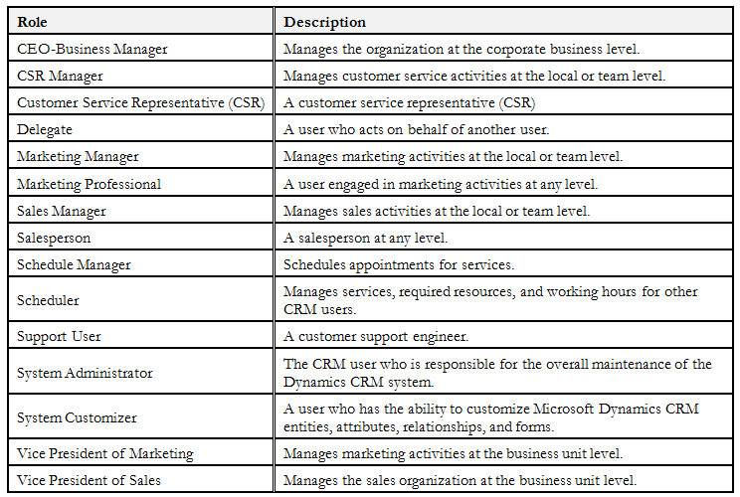
Default Security Roles

Slide 16
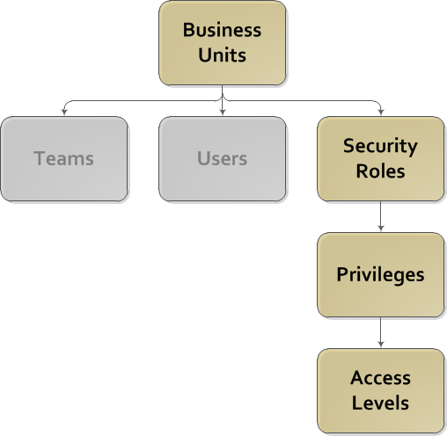
Dynamics CRM Security Overview

Slide 17
Security Role Facts
Each security role resides in the business unit in which it was created
Security roles are automatically inherited by each of its child business units
Inherited security roles cannot be changed
Multiple business units may each contain a role that has the same name, but the access levels for each privilege and record type may be completely different.
A user/team can only be assigned roles that belong to the same business unit to which the user/team is assigned.

Slide 18
Security Role Facts (cont.)
When a role is assigned to a user/team, the user/team has access to all the privileges specified in that role as dictated by its access levels.
If a user/team is assigned more than one role and the access level for a specific record type and privilege conflict between the roles, the access level granted for that record type and privilege is the least restrictive
Roles cannot be moved between business units.
You must create a copy of an existing security role

Slide 19
How is Security Applied
Security is applied each time the user requests to perform a certain operation or view a specific page
Users do not need to “log out” of Dynamics CRM for new security to be applied.

Slide 20
Special Roles (System Administrator)
Has access to all aspects of the Dynamics CRM system
Automatically assigned to the person who installed the Dynamics CRM software
Cannot be deleted
Cannot be modified
The last user assigned to the System Administrator role cannot be disabled
( you must always have one Administrator )

Slide 21
Special Roles (System Customizer)
Enables non-system administrators to perform normal customization actions such as modifying: Forms, views, and mappings.
Has less administrative privileges than the System Administrator role
Cannot create or disable users
Cannot create or disable business units
Numerous other restrictions
Can be modified and privileges modified

Slide 22
Security Role Best Practices
ALWAYS copy an existing role.
DO NOT create a new role from scratch
ONLY add privileges that are required by the role

Slide 23
Privileges
Privileges are Granted at the:
Entity or Record level
Create Account
Delete Contact
Read Lead
or
Task level
Print
Export to Excel

Slide 24
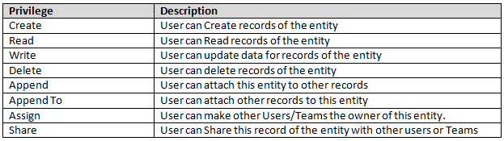
Common privileges for Entities

Slide 25
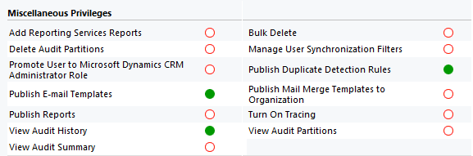
Task-based Privileges:

Slide 26
Access Levels
Work in conjunction with Privileges.
Privileges indicate the actions a user can perform
Define the records the action can be performed upon
Are based on a combination of:
Ownership ( user/team )
Business unit of the owner

Slide 27
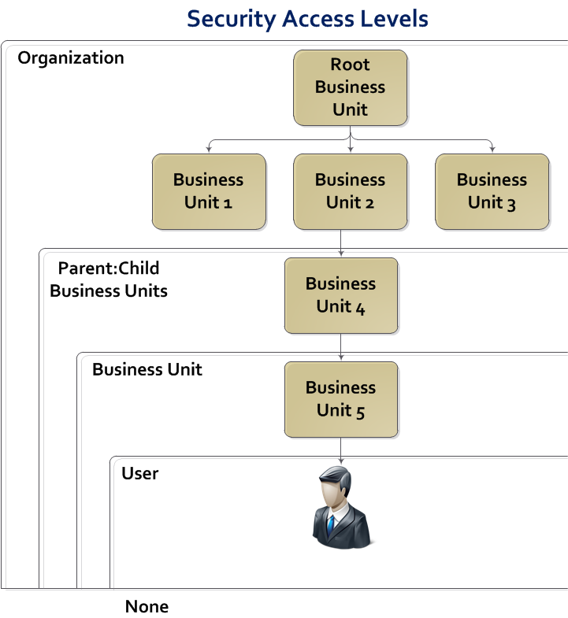
Access Levels

Slide 28
Access Level (None)
No access is provided to the entity or task
The user interface will be modified to remove items related to the task or entity:
Buttons
Navigation items
Menus

Slide 29
Access Level (User)
Grants access to:
Records the user owns
Records owned by someone else that have been shared with the user
Records owned by teams of which the user is a member

Slide 30
Access Level (Business Unit)
Adds to the privileges given to the user
Grants access to records that are owned by or shared with other users assigned to the same business unit

Slide 31
Access Level (Parent:Child Business Unit)
Adds to Business Unit privileges
Grants access to records owned by users and shared with users who are assigned to any child business unit of the user’s current business unit

Slide 32
Access Level (Organization)
Grants access to any record owned by any user within the entire organization, regardless of which business unit the owner belongs to

Slide 33
Working with Users and Teams

Slide 34
Users
Dynamics CRM users map to a user in your authentication source:
Active Directory
Windows Live (??)
Other claims-based system (Office 365)

Slide 35
Licensing
Licensing Mode
Access Mode
Read-Write (the normal license type)
Administrative
Read-Only
License Type
Full
Limited
Device Full
Device Limited

Slide 36
Dynamics CRM User Facts
Users cannot be deleted, only disabled
You can only map one Dynamics CRM user to one authentication source user
Users can be added individually or in batches
Users must belong to at least one security role
Only active Dynamics CRM users can connect to the CRM web site or access CRM assets
Users can be assigned multiple security roles
Moving a user to another business unit will remove all security roles

Slide 37
Team Facts
A Team is group of Dynamics CRM users
Users can belong to more than one team
A team can have users from more than one business unit
Teams can own records
Teams can be assigned security roles
When a record is shared with a team it is implicitly shared with each team member
Teams cannot belong to other teams

Slide 38
Business Unit Teams
Created when the Business Unit is created
Cannot:
be deleted
be renamed
be moved to another Business Unit
have their membership edited.

Slide 39
Encryption

Slide 40
Field Level Security
Can secure custom fields
Cannot secure out of the box fields
Security applied to user or team only
(no security roles)
Data is NOT encrypted

Slide 41
Data Encryption
These specific fields:
Entity | Attribute
EmailServerProfile | IncomingPassword
EmailServerProfile | OutgoingPassword
Mailbox | Password
Queue | EmailPassword
UserSettings | EmailPassword

Slide 42
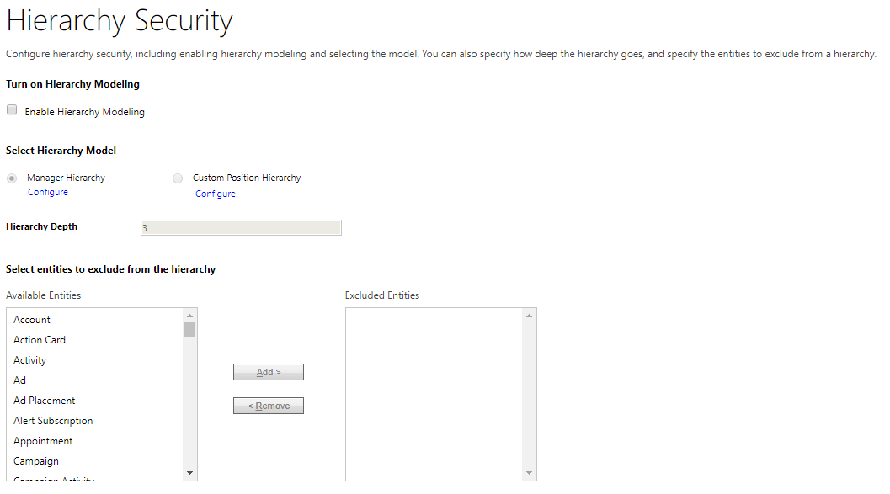
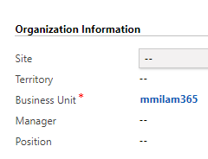
Hierarchical Security

Slide 43
Hierarchical Security
Manager Hierarchy
Managers have rights to all the records owned by their direct reports
Position Hierarchy
Direct higher positions have Read, Write, Update, Append, AppendTo access to the lower positions’ data in the direct ancestor path
Non-direct higher positions, have Read-only access to the lower positions’ data in the direct ancestor path

Slide 44
Discussions

Slide 45
Scenario: Entity Ownership
Requirement:
Your company does not want major record types, Account, Contact, etc., owned by users but rather teams should own all records.

Slide 46
Scenario: Data Obfuscation
Requirement:
Your company periodically makes a copy of the production database and moves it back to the development and test organizations. All contact data must be redacted to prevent inadvertent access.

Slide 47
Scenario: Auto–Share an Account
Requirement:
Your company needs to automatically share an account among a group of sales representatives.

Slide 48
Scenario: Store Credit Card Numbers
Requirement:
Your company offers a subscription service where customers are charged on a monthly basis. You need to store their credit card details so that they may be billed every month.

Slide 49
Questions?

Slide 50
Thank You

